Slide 1


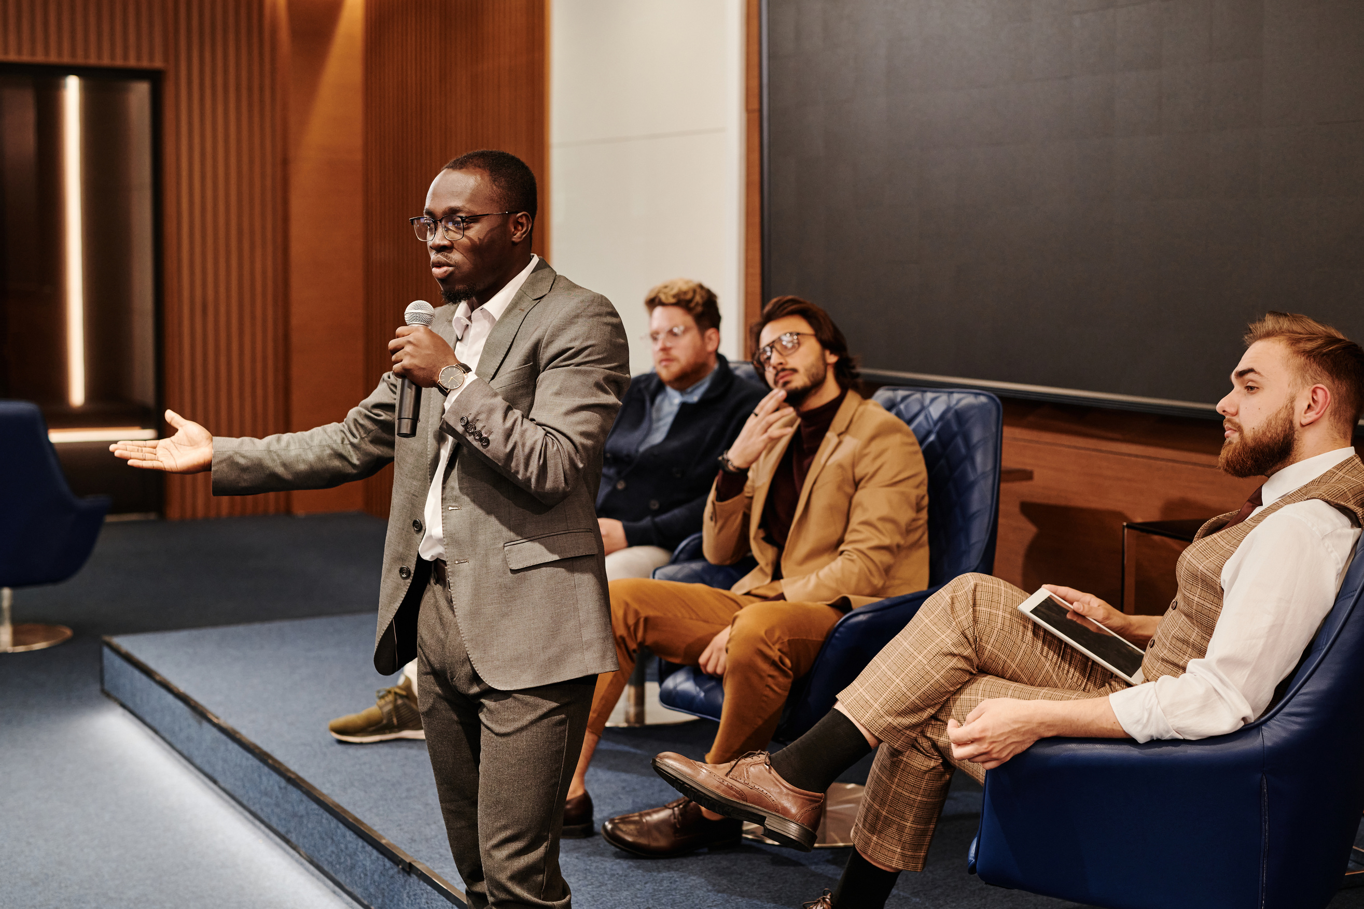

ex-NNSSAB95 Alumni
10 November 2024
Acceptance Speech
Commitment to Progress & Unity
11 November 2024
Adebola Omololu FCA

Slide 2
Thank You
I would like to express my gratitude for the opportunity to serve and to be elected to be President of our alumni.
I have been inspired to lead by the passion of our alumni through various calls, visits & discussions & the confidence bestowed upon me by everyone.
Leadership is a call to serve
Challenges of Sustainable Development

Slide 3
Vision
Vision
To create a vibrant, supportive alumni community that advances the legacy of our school, fosters lifelong connections, and empowers alumni to make a meaningful impact on each other, the school, and the broader community
Mission
To unite and engage alumni in a network of support, mentorship, and service, advancing onward toward a brighter future for all

Slide 4

Goals
O.N.W.A.R.D
• As the foundation of this approach, I would like to introduce acronym ONWARD:
• - O – Outreach to Alumni
• - N – Networking for Career Growth
• - W – Well-being of Current Students
• - A – Advancement of Community
• - R – Reinforce School-Alumni Ties
• - D – Digital Presence and Engagement

Slide 5
ONWARD
05/10
Outreach
The goal is to connect alumni through regular engagement, reunions, communication and newsletters.
Supporting Committees:
- Outreach & Engagement
- Events & Reunions
- Digital & Social Media

Slide 6
ONWARD
Networking
The goal is to explore initiatives for career networking, mentorship, and job support
Supporting Committees:
- Networking & Career Development
- Youth Mentorship & Internship
- Alumni Business & Entrepreneurship

Slide 7
ONWARD
Wellbeing
The goal is to execute initiatives around the physical health, mental health, scholarships & financial support for our alumni as well as current students
Supporting Committees:
- Student Scholarship & Support
- Health & Wellness
- Finance & Fundraising

Slide 8
ONWARD
Advancement of Community
The goal is to execute initiatives around giving back to our society
Supporting Committees:
- Community Service & Outreach

Slide 9
ONWARD
Reinforcement
The goal is to execute initiatives around the need to maintain a strong connection with the school, supporting its growth.
Supporting Committees:
- School Partnership
- Historical Preservation

Slide 10
ONWARD
Digital
The goal is to execute initiatives around maintaining a modern, digital presence for ongoing engagement
Supporting Committees:
- Digital & Social Media
- Technology & Innovation

Slide 11
ONWARD
Call To Action
I would like to encourage alumni to join a committee that aligns with their passions and expertise.
Our EXCO reaffirms our commitment to lead the association toward a thriving, impactful future
.

Slide 12
ONWARD
Thank You!
I thank everyone for your trust and support.
I am excited about the journey ahead and the impact that can be made together

